Slide 1
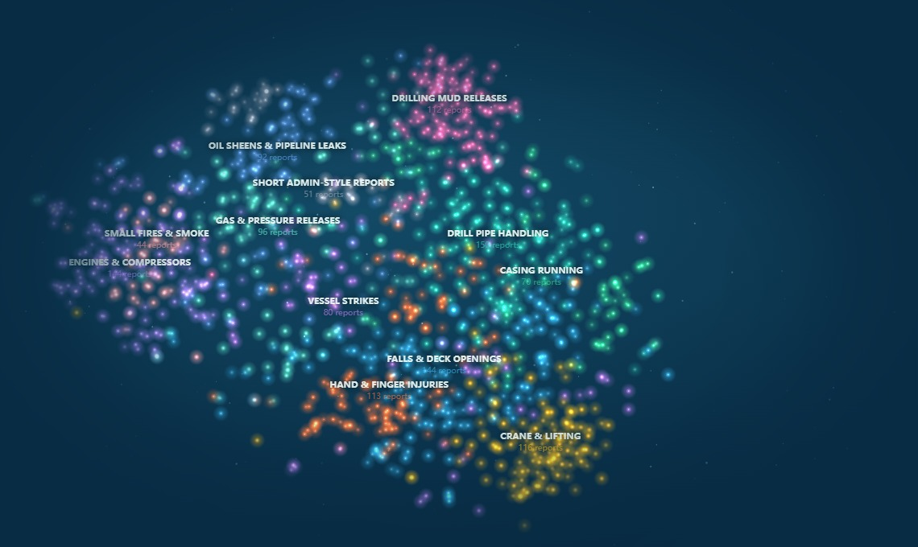

Incident Lens
Learn from 1,200 offshore incident reports without reading every one
Team 2 · Track 9 (Local Business & Industry) · Energy Institute partner challenge
Notes:
Hi, we're Team 2. Incident Lens helps offshore safety teams learn from past incidents without reading every report.

Slide 2
The lessons are buried in free text
1,212
3,572
26%
real offshore incident reports (US federal BSEE data)
cause statements written by investigators
of reports hold a real, actionable fix; the rest is boilerplate
Who it's for: offshore safety teams and incident investigators. When a new incident happens, they need to know: has this happened before, what caused it, and what fix worked?
Notes:
Offshore teams file hundreds of incident reports. The lessons sit in free text, so nobody reads them all and the same incidents happen again.

Slide 3






What we built: one tool, six views
Incident galaxy
Similar incidents
Safety alert
All 1,212 incidents mapped by meaning, with 12 themes found automatically.
Paste a new report and get the closest past incidents and their causes.
One click turns the look-alikes into a printable briefing for the next job.
Cause & why
Gaps & trends
How well it works
Predicts the cause category and highlights the words behind the answer.
Flags reports missing key details and shows themes by year.
Honest scores vs the official baseline, with intervals and limits.
Notes:
Six views. Now a live demo: Galaxy, then the crane example in Similar incidents, Safety alert, then Cause & why with the radio example.

Slide 4
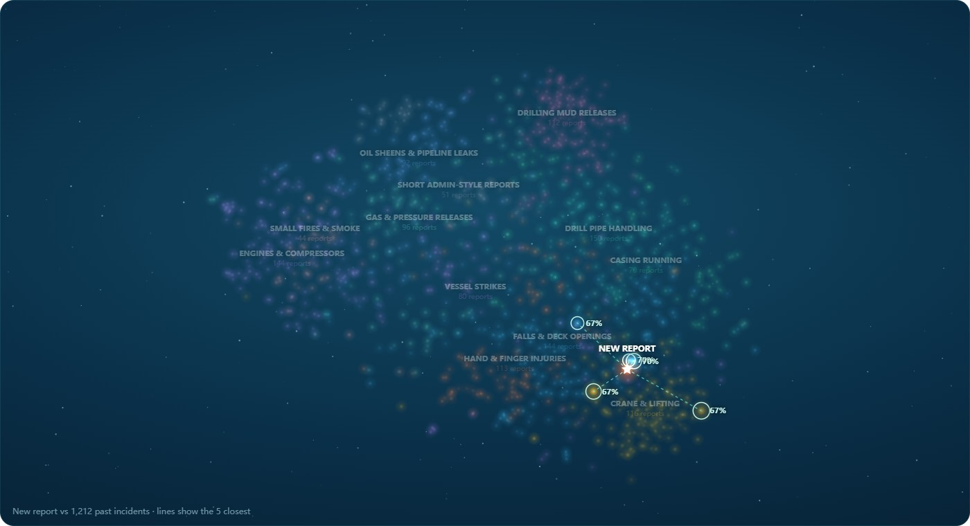
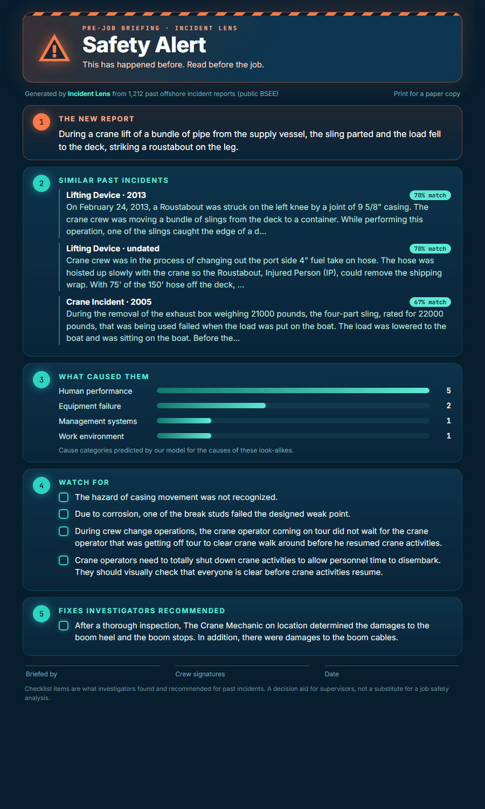
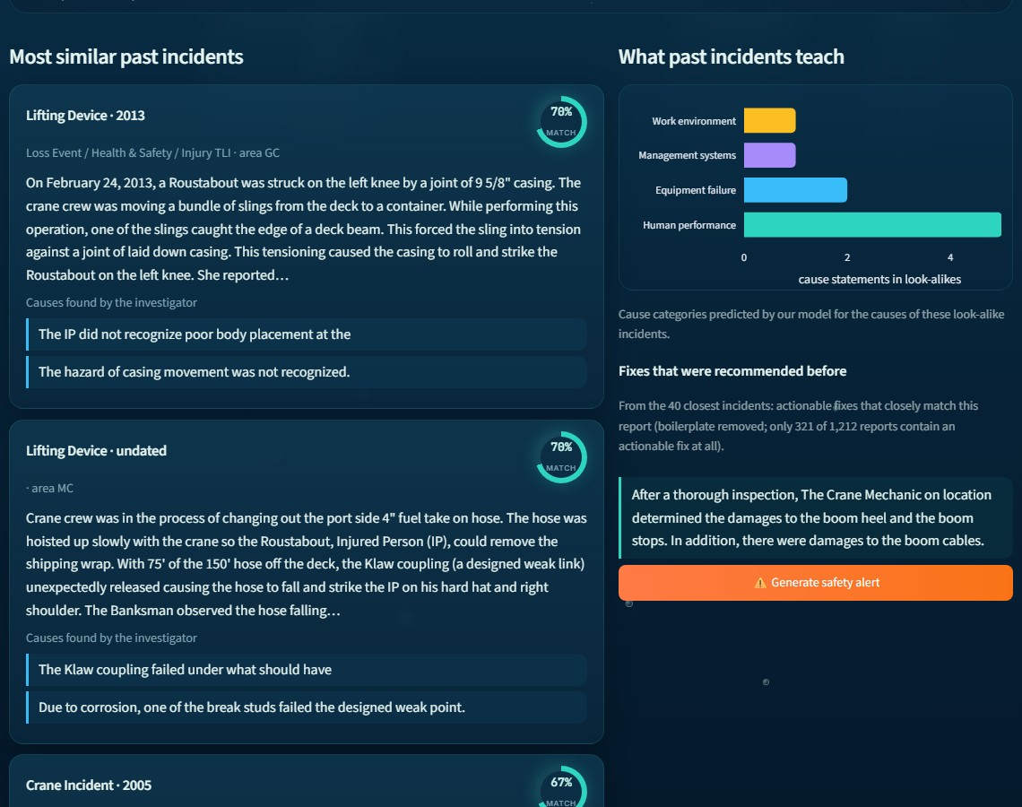
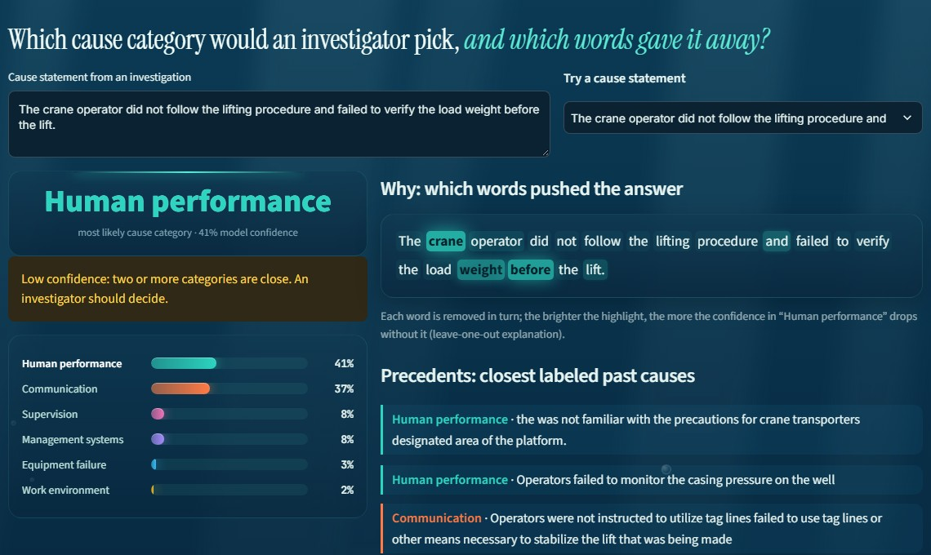
Live demo (screenshots as backup)
A new report lands among 1,212 past incidents
Look-alikes, their causes and past fixes
Cause & why: highlighted words drive the answer
One click: a printable safety alert for the pre-job meeting
Notes:
Only if the live demo fails: walk through these screenshots.

Slide 5
Cause model: macro-F1 0.48 vs baseline 0.35
95% intervals don't overlap: baseline 0.29–0.40, ours 0.42–0.54. The rare categories gain most (Work environment 0.18 → 0.43, Communication 0.18 → 0.39).
Notes:
Same 374 rows, same folds, same metric as the official baseline. Macro-F1 averages over all six categories, so rare ones count as much as common ones. The baseline counts words; we use meaning embeddings, which tell communication from supervision far better.

Slide 6
AI we used and how we checked it
AI inside the product
bge-small text embeddings (open source, runs locally) for similar-incident search
Logistic regression on those embeddings to predict the cause category
Leave-one-word-out highlights to show why
Claude (AI coding assistant) helped write the code; it is not part of the product
How we checked it
374 cause statements, 2019+ only, 5 folds grouped by incident so no incident is in both train and test
Compared with the official baseline and an always-guess-most-common rule, with 95% bootstrap intervals
Our hand labels: 59 causes, 53 incidents, scored only on unseen incidents: 31 agree (53%, CI 40–65%). We matched investigators on 19 of 25.
Most common mistake: Human performance read as Equipment failure (18) or Supervision (16)
Notes:
This is the slide the rules ask for. Left: the AI in the product. Right: how we checked it, including our own hand labels.

Slide 7




Responsible by design, ready to pilot
Runs fully local No API, no data leaves the laptop
Next steps
Load a company's own incident reports
Investigators confirm or correct labels, and the model retrains
Weekly digest: new incidents that look like past serious ones
No names Name fields never shown; obvious names scrubbed
Real data only Synthetic cells excluded from training and scores
Honest limits Matches the investigator's label, not the truth; rare classes have about 27 examples each
github.com/Epinore/incident-lens
Notes:
It runs locally, shows no names and uses real data only. Next: a company's own reports, with investigators correcting labels. Thank you.

